Slide 1
Computer Club 10/2/24
Competitive Programming
Josh Ganschow

Slide 2
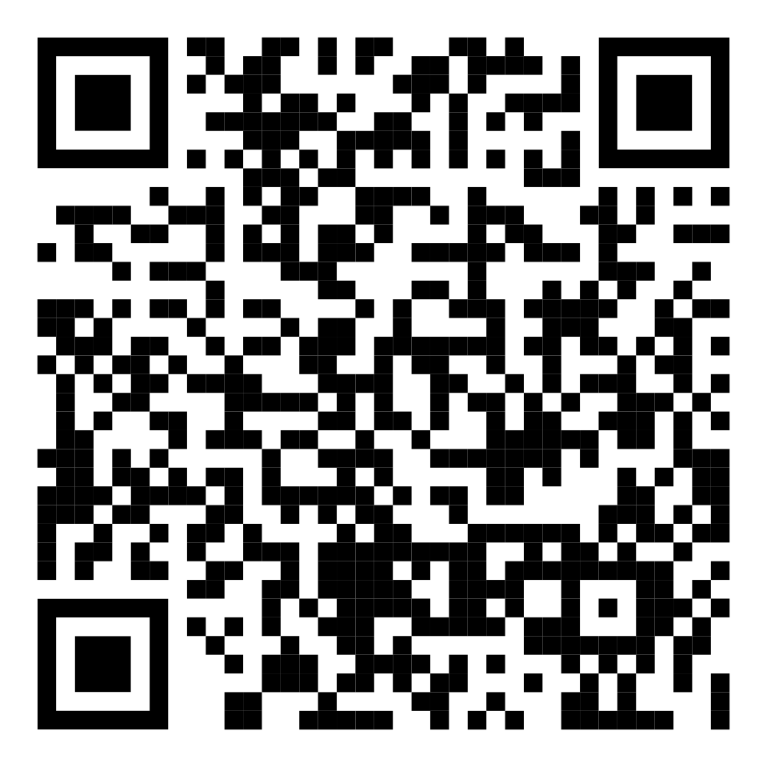
Attendance

Slide 3
Contest on Kattis
Go to open.kattis.com
Sign in or create account (if needed)
Go to “Contests” on the left
Ctrl+f for “DSU” and click “Join the Contest”

Slide 4
Difficulty Breakdown:
Easy
Hello
R2
Digits
Cold-Puter Science
Oddities
Provinces and Gold
Intermediate
Speed Limit
Statistics
Apaxiaaans
Jumble Compass
Autori
Birds on a Wire
Advanced Intermediate
Two Charts Become One
Travel the Skies
Advanced
Abridged Reading
Knapsack
Single Source Shortest Path, Non-Negative Weights
Unique Snowflakes
A Classy Problem
Expert
Frogger
I have solved all the problems, and I have hints to give if you are stuck on any of them. Feel free to group up and work on these problems together!

